Slide 1
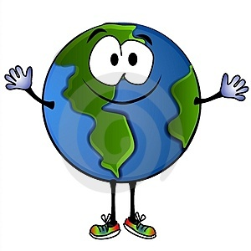
BE A
PLANET
PROTECTOR
ENVIRONMENTAL EDUCATION
ACTIVITIES - 6TH to 8TH

Slide 2
For Teachers:
Green Living Science is a non-profit organization dedicated to increasing awareness of environmental literacy in Detroit. Since 2012 we have partnered with DPSCD to increase awareness of environmental issues facing our city, state and planet.
Our educators designed this presentation as a resource for YOU! Simply pick a slide and pop it up at the beginning of class to have your students think more about what they can do to help our planet! The answers along with informational source are in the notes section of each slide.

Slide 3
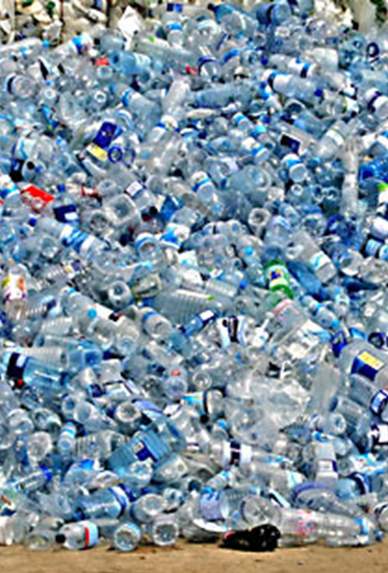
Turn and Talk: Talk with a partner about the ways to practice reducing waste like paper in your classroom.
Reducing means making less waste. If you throw out your plastic water bottle each school day, you’ll have thrown out almost 200 plastic water bottles by the end of the school year! However, if you use the same plastic water bottle over and over, you’ll have reduced the amount of plastic you use.
Notes:
Directions: After students have had time talk with a partner about how to reduce material usage in the classroom allow time for students to share. You can write these down and post them to encourage students to practice them daily. Be certain to discuss how students can reduce the amount of paper they use by using scrap paper.
Image Source: https://www.rappler.com/science-nature/environment/203979-plastic-battle-single-use-bottles-refilling
*Article about ditching single use plastics and switching to refillable containers

Slide 4
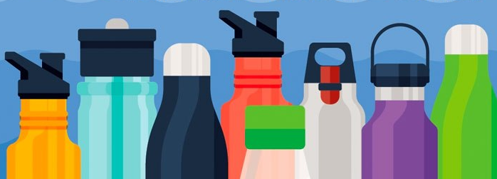
Write Down: One way you can reuse materials in the classroom.
Reusing is another way to make less waste. There are many different ways to practice reuse; you can refill bottles of water, create an art project or shop at thrift stores.
Notes:
Directions: After students have had time to write down a few ways to reuse materials in the classroom allow time for students to share. You can write these down and post them to encourage students to practice them daily. Be certain to discuss how to reuse paper by using the backside after filling up the front, also inform students they can reuse water bottles by filling them up with juice or water.
Source: https://www.epa.gov/recycle/reducing-and-reusing-basics
*Article about the benefits of reusing. Also has examples listed.

Slide 5
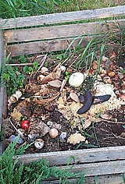
Turn and Talk:
How could you and your neighbors start composting?
Not all of the materials we use should be thrown away; some can be recycled or composted.
Although you can not put left over food into your recycle bin it can be used to make
compost.
Compost is the process of reusing unwanted
food’s nutrients to improve soil, and help
plants grow better.
Notes:
Directions: After students have had time talk with a partner about how to reduce material usage in the classroom allow time for students to share. You can write these down and post them to encourage students to practice them daily. Be certain to discuss how students can reduce the amount of paper they use by using scrap paper.
Image Source: https://www.rappler.com/science-nature/environment/203979-plastic-battle-single-use-bottles-refilling
*Article about ditching single use plastics and switching to refillable containers.

Slide 6
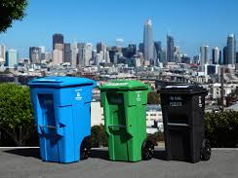
Turn and Talk: Do you think this system could work in Detroit? Explain why you think this waste disposal system could or could not work in Detroit.
Just across the Ambassador Bridge in Canada, many cities use a three cart system to get rid of household waste. One cart is for trash, one for recycling and one is for compost or food waste. All are taken out to the curb and collected just like the trash in Detroit.
Notes:
Directions: Encourage students to discuss what problems might occur when implementing this type of waste disposal system; like pests, improper use of bins, etc.
.

Slide 7
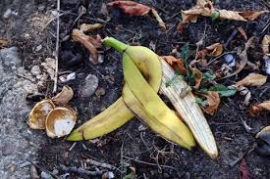
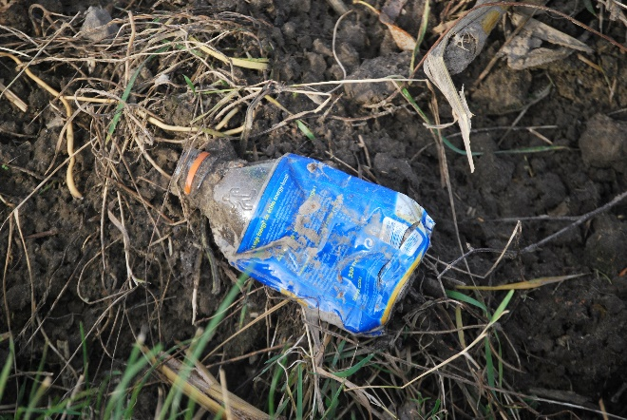
PREDICT: What will happen over time when items like banana or plastic are in nature?
Notes:
Directions: Have students make a prediction about what will happen over time things like a banana or a piece of plastic. Having students compare between the two especially to discuss that a banana will decompose over time while plastics break into smaller and smaller pieces becoming micro-plastics.
Want to learn more? https://www.youtube.com/watch?v=BWGBc53v98E

Slide 8
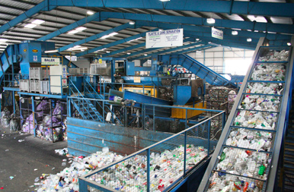
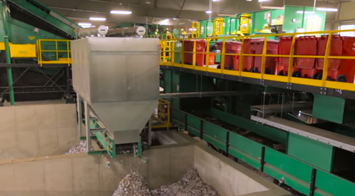
Watch and Draw:
Watch this short video about how recyclables are separated, then draw what you think this machine looks like.
Notes:
Directions: Click on the image and it will direct you to a short video about the Material Recovery Facility sorting process. Then allow time for students to write down the various scientific or engineering concepts required to build the Materials Recovery Facility. Like density, air pressure, force interactions, speed, gravity, and magnets.
Here is the link: https://www.teachertube.com/videos/62098
Here is another link to another video: https://www.youtube.com/watch?v=M5nmNKVNCBw

Slide 9
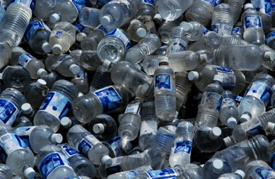
Americans buy more bottled water than any other country in the world, adding 29 billion water bottles a year to the problem. In order to make all these bottles, plastic manufacturers use 17 million barrels of oil. That’s enough oil to keep a million cars going for twelve months.
Create a math story problem:
Using the information from the paragraph above, write a math story problem and solve it!
Notes:
Directions: Allow time for students to share their story with a neighbor and solve together.
-Example: How much oil could be saved if the United States stopped using plastic water bottles for 5 years? What about 10 years?
Source: National Geographic Kids Article, Drinking Water: Bottled or From the Tap? http://kids.nationalgeographic.com/kids/stories/spacescience/water-bottle-pollution/

Slide 10
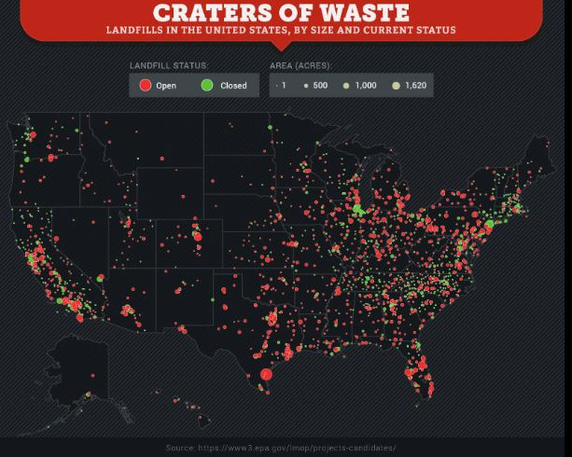
Turn & Talk:
What do you think the dots are showing on the map?
Notes:
Directions: Have students discuss what the red and green dots might represent on the map of the United States. After providing time to discuss, explain that the dots represent landfills – the red dots are the open landfills still accepting garbage and the green dots are closed landfills that have reached their capacity for garbage and have been capped.
Sources: https://www.saveonenergy.com/land-of-waste/

Slide 11
The average person makes over 4 pounds of trash every day.
How much trash does your class create in one week?
How much trash does your class create in an average month (30 days)?
Notes:
Directions: Allow time for students to solve the problems.
Solve by multiplying 4 pounds by the number of students in the class then by 7 days = ___ trash created in one week
Solve by multiplying 4 pounds by the number of students in the class then by 30 days = ___ trash created in one month
Then explain to students that the average American produces about 1.5 tons of waste every year.
Source: Do Something, 11 Facts About Recycling http://www.dosomething.org/actnow/tipsandtools/11-facts-about-recycling

Slide 12
Turn and Match:
Look at the pie chart and match the waste disposal system with each piece of the chart.
Waste Disposal Systems:
Recycle: materials are sent to a facility where they are transformed into new products
Compost: organic materials like yard waste and food scraps are sent to a facility where they decompose over time to create plant fertilizer
Landfill: waste is sent to a place where it is put into the ground and buried up with soil
Incinerator: waste is sent to a facility where is it burned at high temperatures
Notes:
Directions: Have student match the each color of the pie chart to the waste disposal system listed below.
Answers:
-Green: Compost 3%
-Blue: Incinerator 4.5%
-Orange: Landfill 81.5%
-Dark Gray: Recycling 11%

Slide 13
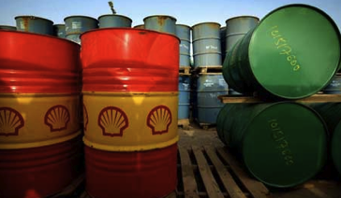
Each year the average American uses 222 plastic water bottles.
If all the bottles are recycled, it would save 7 gallons of oil from being used.
.
How many gallons of oil are used to make one plastic bottle?
How many plastic bottles can be made with one gallon of oil?
Notes:
Directions:
1. Divide 222 bottles by 7 gallons = 31.7 bottles can be made with one gallon of oil
2. Divide 7 gallons by 222 bottles = .03 gallons are used to make one plastic bottle
Source: National Geographic Newswatch, U.S. Bottle Water Sales Are Booming (Again) Despite Opposition http://newswatch.nationalgeographic.com/2012/05/17/u-s-bottled-water-sales-are-booming-again-despite-opposition/

Slide 14
Plastic Audit:
Calculate the number of plastics you use each year.
Notes:
Directions: If possible allow students to use calculators or work in pairs to complete the calculations. Remind students that they will simply put in the number of plastic bottles they use a day then multiply that by the number of days in a year – 365 days to calculate how much plastic they use in a year. By totaling up the last column students will have an idea of how much plastic they generate in a year.
Extension: Calculate how much plastic the entire class uses in a year by adding all the numbers together.

Slide 15
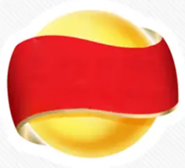
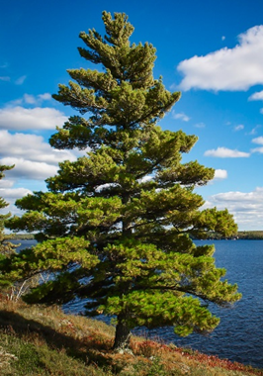
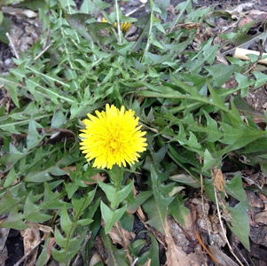
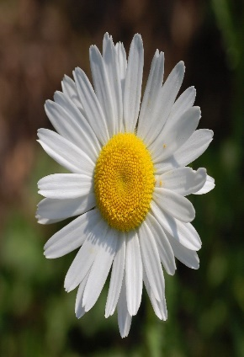
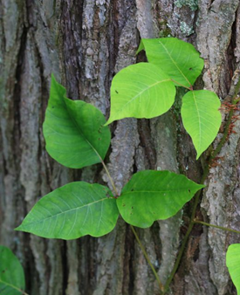
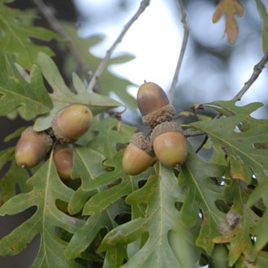
1.
2.
3.
4.
5.
Write:
Number your paper 1 to 10.
Look at the pictures below and identify what type of plant/flower or logo it is.
7.
9.
6.
8.
10.
Notes:
Directions: Have students number their paper from 1 to 10 and guess what each plant/flower or logo is in each photo. Purpose of this is to see if students find more logos recognizable compared to plants.
Answers:
Monster
Nike
Lays
Apple
McDonalds
Eastern White Pine – Michigan’s state tree
Daisy
Poison Ivy
Dandelion
Oak tree leaves and acorns

Slide 16
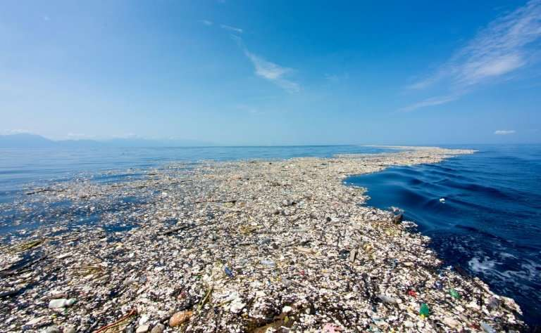
Turn & Talk:
What do you see in this image and what could have caused this?
Notes:
Directions: After students have had time to predict and write, allow students to share. Then explain this is one image of the garbage patches that are in our oceans. Due to the gyre that naturally occur in our oceans trash and pollutants circulate in them – causing plastics to break down over time creating micro-plastics.
Sources:
https://theoceancleanup.com/great-pacific-garbage-patch/
https://phys.org/news/2018-03-pacific-plastic-dump-larger.html

Slide 17
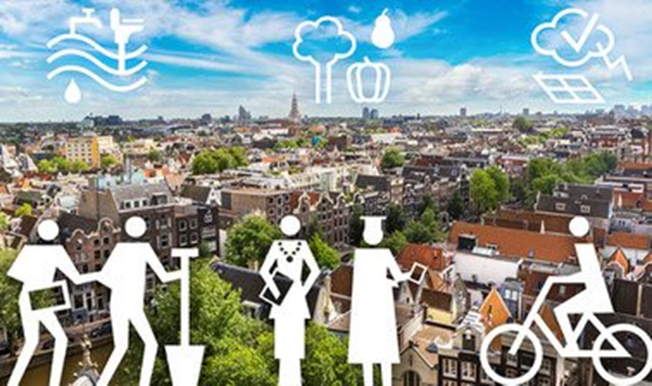
Be sure to include the three concepts below in your design:
Design:
Draw and label design for a sustainable city that has little impact on the environment.
1. Transportation – how people will get around
2. Waste – where does it go, how it is collected
3. Electricity – how is electricity generated and monitored
Notes:
Directions: Allow students time to draw and label a city that is sustainable – meaning it has little or no impact on the environment.
Including:
-Transportation: public transportation, charging stations for electric vehicles,
-Waste: recycling and composting provided to all residents, trash/garbage is not buried in the ground but and alternative is provided like an updated incinerator
-Electricity: electricity is not generated using fossil fuels but renewable energies like solar, wind, geothermal.
Source: https://www.climaterealityproject.org/blog/five-sustainable-cities-making-difference-planet
This article has information about cities that are making efforts to be more sustainable.

Slide 18
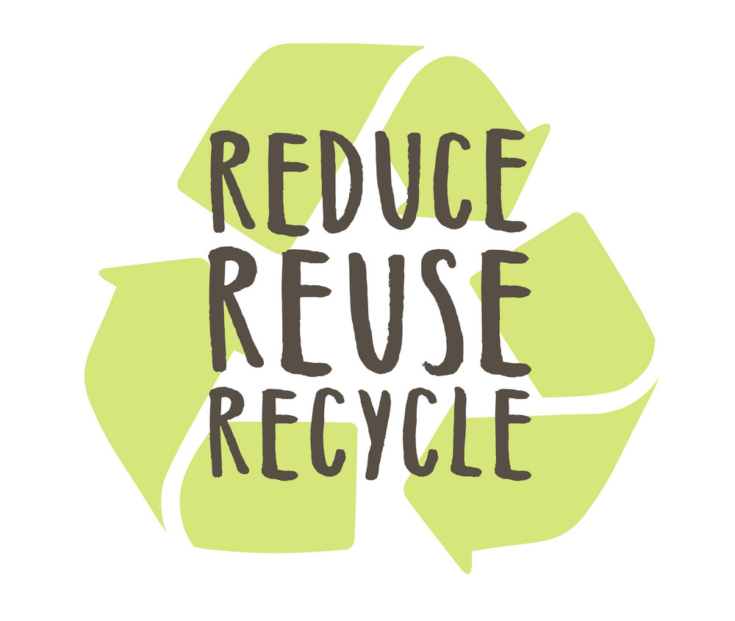
Beyond the 3Rs: Reduce, Reuse, Recycle
Sometimes practices the 3Rs is not enough when it comes to helping the Earth.
Write:
What are other R words that could be added to the 3Rs that could be practiced to help the planet?
Be sure to include an explanation why your R word is a good addition.
Notes:
Directions: Allow time for students to write what R word would be a good addition then allow some time to share.
Some examples of other R words:
Refuse: to chose not to buy or do without – like plastic bags at the grocery store, do you need that bag or can you carry the few items
Respect: to treat with consideration – the natural world around you and how your actions impact the other species that live on our planet.
Repair: instead of going out and buying something new because it broke, find a way to fix it!
Replace: change wasteful habits like drinking a pop out of plastic to drinking pop out of a metal can since metal can be recycled more easily.
Rethink: thinking about your actions and how they impact the planet, if you think first then act like making sure your trash ends up in the trashcan and not on the ground

Slide 19
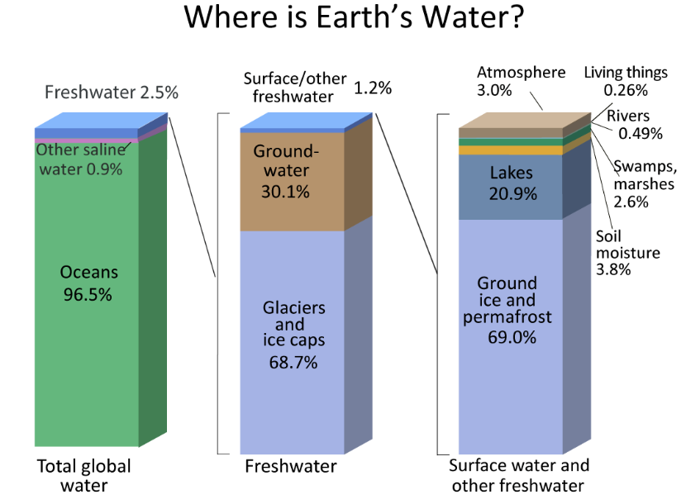
Turn and Talk:
Looking at the graph, determine what percentage of water is fresh.
Notes:
Directions: Have students pair up to interpret what the graph is showing them. After allowing them time to discuss ask students to share what percentage of water on Earth is fresh water. Answer: 2.5% Then ask students if the graph shows how much water is clean and accessible for humans to drink. Breakdown 1.2% from third bar ?!
Source: https://www.usgs.gov/special-topic/water-science-school/science/where-earths-water?qt-science_center_objects=0#qt-science_center_objects

Slide 20
For more information about Green Living Science or to help your students receive a free recycling cart at home please contact info@greenlivingscience.org or call 313-871-4000 Ext. 3

